Slide 1
Chapter 03
Decision Making or Conditionals.

Slide 2
Decision Making in Java (if-else, switch, break, continue, jump)
Decision-making in programming is similar to decision-making in real life. In programming, we also face situations where we want a certain block of code to be executed when some condition is full filled.
A programming language uses control statements to control the flow of execution of a program based on certain conditions. Java provides several control statements to manage program flow, including:
  Conditional Statements: if, if-else, nested-if, if-else-if.
  Switch-Case: For multiple fixed-value checks.
  Jump Statements: break, continue, return.
Types of Decision-Making Statements
  if
  if-else
  if-else-if
  switch-case
  nested-if
  jump - break, continue, return

Slide 3
Comparison Operators
Operator | Meaning
== | Equal
!= | Not Equal
> | Greater
< | Less than
>= | Greater or Equal
<= | Less or Equal

Slide 4
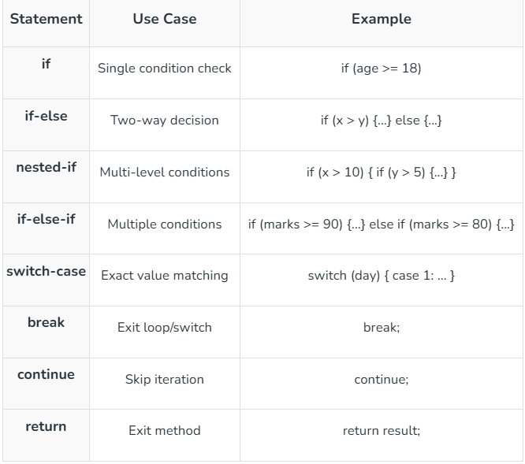
Syntax.
The table below demonstrates various control flow statements in programming, their use cases, and examples of their syntax.

Slide 5
1. Java if Statement
The if statement is the most simple decision-making statement. It is used to decide whether a certain statement or block of statements will be executed or not i.e. if a certain condition is true then a block of statements is executed otherwise not.
Use when you want to run code only if a condition is true.
Syntax:
if (condition) {
// code to run if condition is true
}
Java if Statement
The if statement is used to check a condition (True/False).
If the condition is true, the code inside the if block will run.
If the condition is false, the code inside will be skipped.

Slide 6
Example
.
public class ChapterThreeCondtionals {
public static void main(String[] args) {
int age = 20;
if (age >= 18) { // condition
System.out.println("You are an adult."); // runs if true
}
}
}

Slide 7
2. Java if-else Statement.
Use when you want to do one thing if true, and a different thing if false.
Syntax:
if (expression/condition) {
Code to execute if condition is true.
}
else {
Code to execute if condition is true.
}
How it works:
Java checks the condition inside if → (age >= 18).
If the condition is true, the if block runs.
If the condition is false, the else block runs.

Slide 8
Example
.
public class ChapterThreeCondtionals {
public static void main(String[] args) {
int age = 16;
if (age >= 18) {
System.out.println("Adult");
} else {
System.out.println("Not adult");
}
}

Slide 9
4. if - else if
Use when you have several choices to check in order or multiple conditions.
How it works
Java checks conditions from top to bottom.
If one condition is true, its block runs, and Java skips the rest.
If none are true, the else block runs.
👉 In the example:
marks = 75 → first condition (marks >= 90) is false.
Second condition (marks >= 75) is true → so it prints "Grade B".
The rest are skipped.
Syntax
if else if statement
if (condition1) {
// code if condition1 is true.
}
elseif (condition2) {
// code if condition2 is true.
}
elseif (condition3) {
// code if condition3 is true.
}
else {
// code if none of the above conditions are true.
}

Slide 10
Example
public class ChapterThreeCondtionals {
public static void main(String[] args) {
int score = 85;
if (score >= 90) {
System.out.println("Grade A");
} else if (score >= 80) {
System.out.println("Grade B");
} else if (score >= 70) {
System.out.println("Grade C");
} else {
System.out.println("Fail or lower grade");
}
}
}
public class ChapterThreeCondtionals {
public static void main(String[] args) {
int age=20;
if(age >100){
System.out.println("qaan gaadh");
} else if (age >150) {
System.out.println("wali");
} else if (age > 10) {
System.out.println("caruur");
}
}
}
.

Slide 11
public class ChapterThreeConditionals {
public static void main(String[] args) {
int marks = 500;
if (marks > 100 || marks < 0) {
System.out.println("Invalid marks! Please enter between 0 and 100.");
} else if (marks >= 90) {
System.out.println("Grade A");
} else if (marks >= 80) {
System.out.println("Grade B");
} else if (marks >= 70) {
System.out.println("Grade C");
} else if (marks >= 60) {
System.out.println("Grade D");
} else {
System.out.println("Fail");
}
}
}

Slide 12
5. switch-case
The switch statement evaluates its expression, then executes all statements that follow the matching case label.
The switch statement checks a value, then runs the code under the case that matches it.
Syntax
switch (variable){
case value1:
// code if variable ==
value1
break;
case value2:
// code if variable ==
value2
break;
default:
// code if no match is found
}
How it works
Java evaluates the expression inside switch.
It compares the result with each case.
If a match is found → the code under that case runs.
The break statement stops the switch (so the program doesn’t “fall through” to the next case).
If no case matches → the default block runs (optional).

Slide 13
Example
.
public class ChapterThreeCondtionals {
public static void main(String[] args) {
int day = 3;
switch (day) {
case 1: System.out.println("Monday"); break;
case 2: System.out.println("Tuesday"); break;
case 3: System.out.println("Wednesday"); break;
default: System.out.println("Other day");
}
}
}

Slide 14
Used to change the normal flow of the program.
a) break
Stops the loop or switch immediately.
Syntax
break;
Example
public class ChapterThreeCondtionals {
public static void main(String[] args) {
for (int i = 1; i <= 5; i++) {
if (i == 3) break;
System.out.println(i);
}
} }

Slide 15
b) continue.
Skips the current loop iteration, moves to the next.
Syntax
continue;
Example
public class ChapterThreeCondtionals {
public static void main(String[] args) {
for (int i = 1; i <= 5; i++) {
if (i == 3) continue;
System.out.println(i);
} } }

Slide 16
c) return
Ends a method immediately and optionally sends back a value.
Syntax
return; // for methods with void return type
return value; // for methods that return a value
Example
public class ChapterThreeCondtionals {
static int add(int a, int b) {
return a + b; // exits method and gives result
}
public static void main(String[] args) {
System.out.println(add(5, 3));
}
}

Slide 17
3. nested-if
if inside another if. Used when you want to check more than one condition step by step.
Syntax:-
if (condition1) {
// runs if condition1 is true
if (condition2) {
// runs if condition1 AND condition2 are true
} else {
// runs if condition1 is true but condition2 is false
}
} else {
// runs if condition1 is false
}
How it works:
Java checks the outer if (age >= 18).
If false → it skips inside and goes to the else.
If true → it enters the inner if.
Inside, it checks the inner if (hasID).
If true → "You can enter."
If false → "You need an ID."

Slide 18
Example
.
public class ChapterThreeCondtionals {
public static void main(String[] args) {
int age = 16;
if (age >= 18) {
System.out.println("Adult");
} else {
System.out.println("Not adult");
} else {System.out.println("Not adult");
}
}

Slide 19
Next
Loops and Booleans

